Slide 1
Notes:
Princess Sumaya University
4241 - Digital Logic Design
Dr. Bassam Kahhaleh

Slide 2
Combinational Circuits
Output is function of input only
  i.e. no feedback
  When input changes, output may change (after a delay)
Combinational
Circuits
n inputs
m outputs
•
•
•
•
•
•
✗
Eastern Mediterranean University
<number> / 65
Notes:
Princess Sumaya University
4241 - Digital Logic Design
Dr. Bassam Kahhaleh

Slide 3
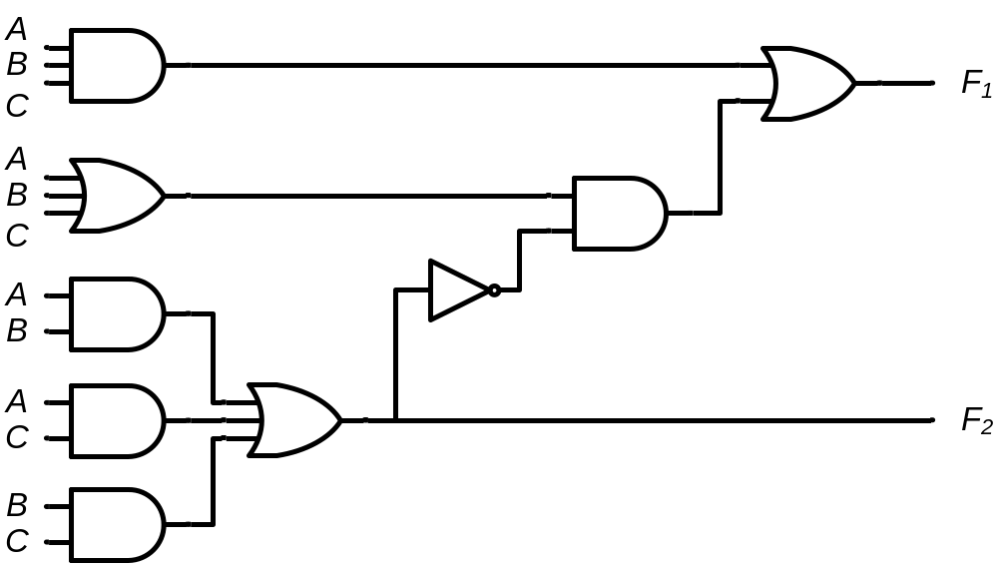
Combinational Circuits
Analysis
  Given a circuit, find out its function
  Function may be expressed as:
    Boolean function
    Truth table
Design
  Given a desired function, determine its circuit
  Function may be expressed as:
    Boolean function
    Truth table
?
?
?
Eastern Mediterranean University
<number> / 65
Notes:
Princess Sumaya University
4241 - Digital Logic Design
Dr. Bassam Kahhaleh

Slide 4
Analysis Procedure
Boolean Expression Approach
T₂=ABC
T₁=A+B+C
T₃=AB'C'+A'BC'+A'B'C
F’₂=(A’+B’)(A’+C’)(B’+C’)
F₂=AB+AC+BC
F₁=AB'C'+A'BC'+A'B'C+ABC
F₂=AB+AC+BC
Eastern Mediterranean University
<number> / 65
Notes:
Princess Sumaya University
4241 - Digital Logic Design
Dr. Bassam Kahhaleh

Slide 5
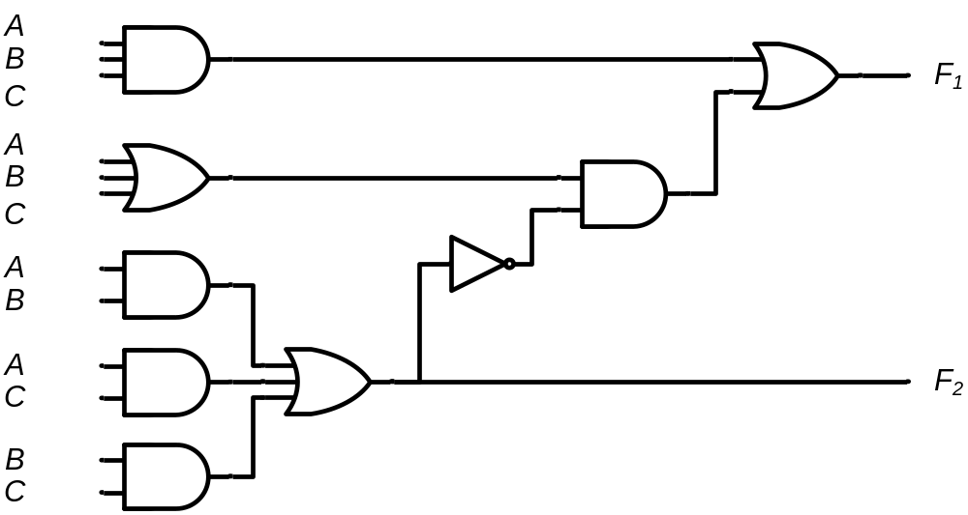
Analysis Procedure
Truth Table Approach
A B C | F₁ | F₂
0 0 0
= 0
= 0
= 0
= 0
= 0
= 0
= 0
= 0
= 0
= 0
= 0
= 0
0 0
0
0
0
0
0
0
0
1
0
Eastern Mediterranean University
<number> / 65
Notes:
Princess Sumaya University
4241 - Digital Logic Design
Dr. Bassam Kahhaleh

Slide 6
Analysis Procedure
Truth Table Approach
A B C | F₁ | F₂
0 0 0 | 0 | 0
0 0 1
= 0
= 0
= 1
= 0
= 0
= 1
= 0
= 0
= 0
= 1
= 0
= 1
0
1
0
0
0
1
1 0
1
1
0
Eastern Mediterranean University
<number> / 65
Notes:
Princess Sumaya University
4241 - Digital Logic Design
Dr. Bassam Kahhaleh

Slide 7
Analysis Procedure
Truth Table Approach
A B C | F₁ | F₂
0 0 0 | 0 | 0
0 0 1 | 1 | 0
0 1 0
= 0
= 1
= 0
= 0
= 1
= 0
= 0
= 1
= 0
= 0
= 1
= 0
0
1
0
0
0
1
1 0
1
1
0
Eastern Mediterranean University
<number> / 65
Notes:
Princess Sumaya University
4241 - Digital Logic Design
Dr. Bassam Kahhaleh

Slide 8
Analysis Procedure
Truth Table Approach
A B C | F₁ | F₂
0 0 0 | 0 | 0
0 0 1 | 1 | 0
0 1 0 | 1 | 0
0 1 1
= 0
= 1
= 1
= 0
= 1
= 1
= 0
= 1
= 0
= 1
= 1
= 1
0
1
0
0
1
0
0
0 1
0
1
Eastern Mediterranean University
<number> / 65
Notes:
Princess Sumaya University
4241 - Digital Logic Design
Dr. Bassam Kahhaleh

Slide 9
Analysis Procedure
Truth Table Approach
A B C | F₁ | F₂
0 0 0 | 0 | 0
0 0 1 | 1 | 0
0 1 0 | 1 | 0
0 1 1 | 0 | 1
1 0 0
= 1
= 0
= 0
= 1
= 0
= 0
= 1
= 0
= 1
= 0
= 0
= 0
0
1
0
0
0
1
1
1
1 0
0
Eastern Mediterranean University
<number> / 65
Notes:
Princess Sumaya University
4241 - Digital Logic Design
Dr. Bassam Kahhaleh

Slide 10
Analysis Procedure
Truth Table Approach
A B C | F₁ | F₂
0 0 0 | 0 | 0
0 0 1 | 1 | 0
0 1 0 | 1 | 0
0 1 1 | 0 | 1
1 0 0 | 1 | 0
1 0 1
= 1
= 0
= 1
= 1
= 0
= 1
= 1
= 0
= 1
= 1
= 0
= 1
0
1
0
1
0
0
0
0
0 1
1
Eastern Mediterranean University
<number> / 65
Notes:
Princess Sumaya University
4241 - Digital Logic Design
Dr. Bassam Kahhaleh

Slide 11
Analysis Procedure
Truth Table Approach
A B C | F₁ | F₂
0 0 0 | 0 | 0
0 0 1 | 1 | 0
0 1 0 | 1 | 0
0 1 1 | 0 | 1
1 0 0 | 1 | 0
1 0 1 | 0 | 1
1 1 0
= 1
= 1
= 0
= 1
= 1
= 0
= 1
= 1
= 1
= 0
= 1
= 0
0
1
1
0
0
0
0
0
0 1
1
Eastern Mediterranean University
<number> / 65
Notes:
Princess Sumaya University
4241 - Digital Logic Design
Dr. Bassam Kahhaleh

Slide 12
Analysis Procedure
Truth Table Approach
A B C | F₁ | F₂
0 0 0 | 0 | 0
0 0 1 | 1 | 0
0 1 0 | 1 | 0
0 1 1 | 0 | 1
1 0 0 | 1 | 0
1 0 1 | 0 | 1
1 1 0 | 0 | 1
1 1 1
= 1
= 1
= 1
= 1
= 1
= 1
= 1
= 1
= 1
= 1
= 1
= 1
1
1
1
1
1
1
0
0
1
1 1
 |  |  |  | B
 |  | 0 | 1 | 0 | 1
A |  | 1 | 0 | 1 | 0
 |  |  | C
 |  |  |  | B
 |  | 0 | 0 | 1 | 0
A |  | 0 | 1 | 1 | 1
 |  |  | C
F₁=AB'C'+A'BC'+A'B'C+ABC
F₂=AB+AC+BC
Eastern Mediterranean University
<number> / 65
Notes:
Princess Sumaya University
4241 - Digital Logic Design
Dr. Bassam Kahhaleh

Slide 13
Design Procedure
Given a problem statement:
  Determine the number of inputs and outputs
  Derive the truth table
  Simplify the Boolean expression for each output
  Produce the required circuit
Example:
Design a circuit to convert a “BCD” code to “Excess 3” code
4-bits
0-9 values
?
4-bits
Value+3
Eastern Mediterranean University
<number> / 65
Notes:
Princess Sumaya University
4241 - Digital Logic Design
Dr. Bassam Kahhaleh

Slide 14
Design Procedure
BCD-to-Excess 3 Converter
 |  |  |  | C
 |  |  | 1 | 1 | 1 | B
A |  | x | x | x | x
 |  | 1 | 1 | x | x
 |  |  | D
 |  |  |  | C
 |  |  | 1 | 1 | 1
 |  | 1 |  |  |  | B
A |  | x | x | x | x
 |  |  | 1 | x | x
 |  |  | D
A B C D | w x y z
0 0 0 0 | 0 0 1 1
0 0 0 1 | 0 1 0 0
0 0 1 0 | 0 1 0 1
0 0 1 1 | 0 1 1 0
0 1 0 0 | 0 1 1 1
0 1 0 1 | 1 0 0 0
0 1 1 0 | 1 0 0 1
0 1 1 1 | 1 0 1 0
1 0 0 0 | 1 0 1 1
1 0 0 1 | 1 1 0 0
1 0 1 0 | x x x x
1 0 1 1 | x x x x
1 1 0 0 | x x x x
1 1 0 1 | x x x x
1 1 1 0 | x x x x
1 1 1 1 | x x x x
w = A+BC+BD
x = B’C+B’D+BC’D’
 |  |  |  | C
 |  | 1 |  | 1
 |  | 1 |  | 1 |  | B
A |  | x | x | x | x
 |  | 1 |  | x | x
 |  |  | D
 |  |  |  | C
 |  | 1 |  |  | 1
 |  | 1 |  |  | 1 | B
A |  | x | x | x | x
 |  | 1 |  | x | x
 |  |  | D
y = C’D’+CD
z = D’
Eastern Mediterranean University
<number> / 65
Notes:
Princess Sumaya University
4241 - Digital Logic Design
Dr. Bassam Kahhaleh

Slide 15
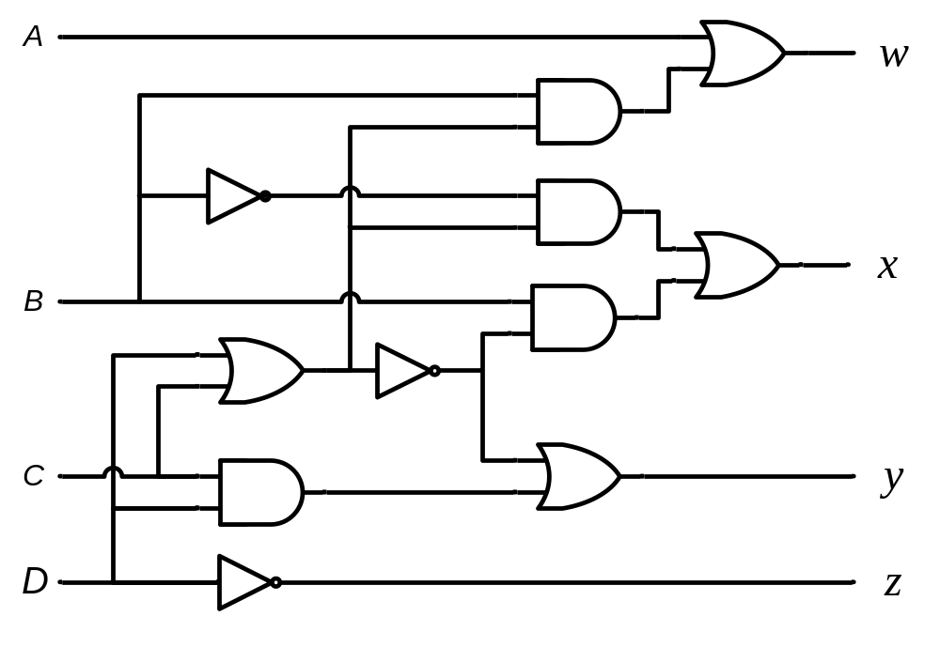
Design Procedure
BCD-to-Excess 3 Converter
A B C D | w x y z
0 0 0 0 | 0 0 1 1
0 0 0 1 | 0 1 0 0
0 0 1 0 | 0 1 0 1
0 0 1 1 | 0 1 1 0
0 1 0 0 | 0 1 1 1
0 1 0 1 | 1 0 0 0
0 1 1 0 | 1 0 0 1
0 1 1 1 | 1 0 1 0
1 0 0 0 | 1 0 1 1
1 0 0 1 | 1 1 0 0
1 0 1 0 | x x x x
1 0 1 1 | x x x x
1 1 0 0 | x x x x
1 1 0 1 | x x x x
1 1 1 0 | x x x x
1 1 1 1 | x x x x
w = A + B(C+D)
y = (C+D)’ + CD
x = B’(C+D) + B(C+D)’
z = D’
Eastern Mediterranean University
<number> / 65
Notes:
Princess Sumaya University
4241 - Digital Logic Design
Dr. Bassam Kahhaleh

Slide 16
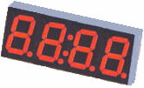
Seven-Segment Decoder
a
w x y z | a b c d e f g
0 0 0 0 | 1 1 1 1 1 1 0
0 0 0 1 | 0 1 1 0 0 0 0
0 0 1 0 | 1 1 0 1 1 0 1
0 0 1 1 | 1 1 1 1 0 0 1
0 1 0 0 | 0 1 1 0 0 1 1
0 1 0 1 | 1 0 1 1 0 1 1
0 1 1 0 | 1 0 1 1 1 1 1
0 1 1 1 | 1 1 1 0 0 0 0
1 0 0 0 | 1 1 1 1 1 1 1
1 0 0 1 | 1 1 1 1 0 1 1
1 0 1 0 | x x x x x x x
1 0 1 1 | x x x x x x x
1 1 0 0 | x x x x x x x
1 1 0 1 | x x x x x x x
1 1 1 0 | x x x x x x x
1 1 1 1 | x x x x x x x
w
x
y
z
a
b
c
d
e
f
g
f
b
?
g
e
c
BCD code
d
 |  |  |  | y
 |  | 1 |  | 1 | 1
 |  |  | 1 | 1 | 1 | x
w |  | x | x | x | x
 |  | 1 | 1 | x | x
 |  |  | z
a = w + y + xz + x’z’
b = . . .
c = . . .
d = . . .
Eastern Mediterranean University
<number> / 65
Notes:
Princess Sumaya University
4241 - Digital Logic Design
Dr. Bassam Kahhaleh

Slide 17
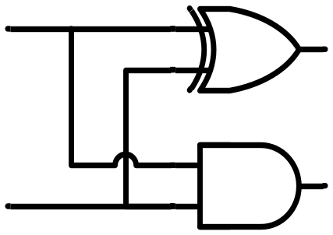
Binary Adder
Half Adder
  Adds 1-bit plus 1-bit
  Produces Sum and Carry
x
y
S
C
HA
x
+ y
───
C S
x y | C S
0 0 | 0 0
0 1 | 0 1
1 0 | 0 1
1 1 | 1 0
x
y
S
C
Eastern Mediterranean University
<number> / 65
Notes:
Princess Sumaya University
4241 - Digital Logic Design
Dr. Bassam Kahhaleh

Slide 18
Binary Adder
Full Adder
  Adds 1-bit plus 1-bit plus 1-bit
  Produces Sum and Carry
x
y
z
S
C
FA
x
+ y
+ z
───
C S
x y z | C S
0 0 0 | 0 0
0 0 1 | 0 1
0 1 0 | 0 1
0 1 1 | 1 0
1 0 0 | 0 1
1 0 1 | 1 0
1 1 0 | 1 0
1 1 1 | 1 1
 |  |  |  | y
 |  | 0 | 1 | 0 | 1
x |  | 1 | 0 | 1 | 0
 |  |  | z
S = xy'z'+x'yz'+x'y'z+xyz = x ⊕ y ⊕ z
 |  |  |  | y
 |  | 0 | 0 | 1 | 0
x |  | 0 | 1 | 1 | 1
 |  |  | z
C = xy + xz + yz
Eastern Mediterranean University
<number> / 65
Notes:
Princess Sumaya University
4241 - Digital Logic Design
Dr. Bassam Kahhaleh

Slide 19
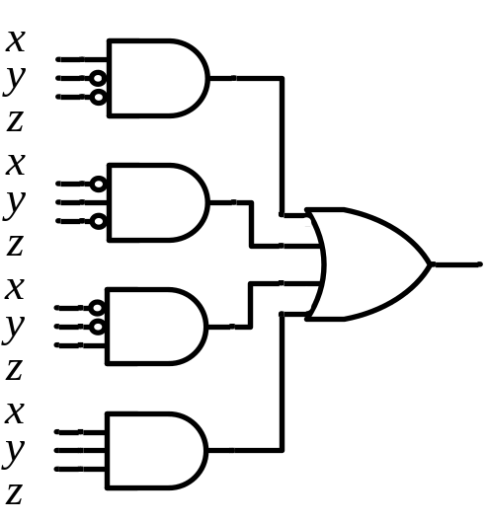
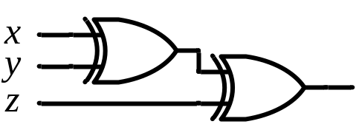
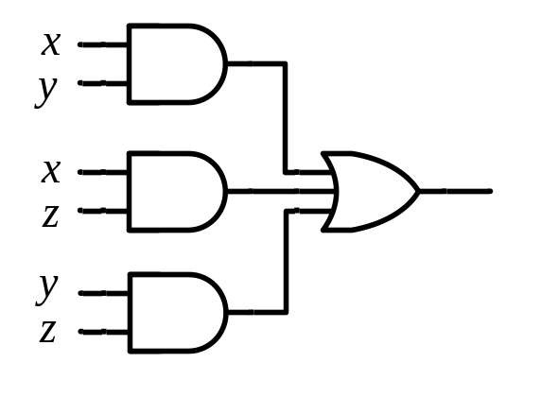
Binary Adder
Full Adder
S = xy'z'+x'yz'+x'y'z+xyz = x ⊕ y ⊕ z
C = xy + xz + yz
x
y
z
S
C
S
C
x
y
z
Eastern Mediterranean University
<number> / 65
Notes:
Princess Sumaya University
4241 - Digital Logic Design
Dr. Bassam Kahhaleh

Slide 20

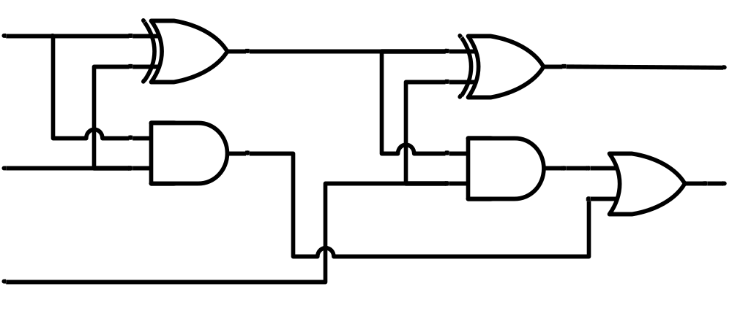
Binary Adder
Full Adder
HA
HA
x
y
z
S
C
x
y
z
S
C
Eastern Mediterranean University
<number> / 65
Notes:
Princess Sumaya University
4241 - Digital Logic Design
Dr. Bassam Kahhaleh

Slide 21
Binary Adder
x₃x₂x₁x₀ y₃y₂y₁y₀
c₃ c₂ c₁ .
+ x₃ x₂ x₁ x₀
+ y₃ y₂ y₁ y₀
────────
Cy S₃ S₂ S₁ S₀
Binary Adder
Carry Propagate Addition
C_{y}
C₀
S₃S₂S₁S₀
x₃ x₂ x₁ x₀
y₃ y₂ y₁ y₀
0
FA
FA
FA
FA
C₄ C₃ C₂ C₁
S₃ S₂ S₁ S₀
Eastern Mediterranean University
<number> / 65
Notes:
Princess Sumaya University
4241 - Digital Logic Design
Dr. Bassam Kahhaleh

Slide 22
Binary Adder
Carry Propagate Adder
x₇ x₆ x₅ x₄
x₃ x₂ x₁ x₀
y₇ y₆ y₅ y₄
y₃ y₂ y₁ y₀
CPA
CPA
A₃ A₂ A₁ A₀
B₃ B₂ B₁ B₀
A₃ A₂ A₁ A₀
B₃ B₂ B₁ B₀
C_{y}
C₀
C_{y}
C₀
0
S₃ S₂ S₁ S₀
S₃ S₂ S₁ S₀
S₇ S₆ S₅ S₄
S₃ S₂ S₁ S₀
Eastern Mediterranean University
<number> / 65
Notes:
Princess Sumaya University
4241 - Digital Logic Design
Dr. Bassam Kahhaleh

Slide 23
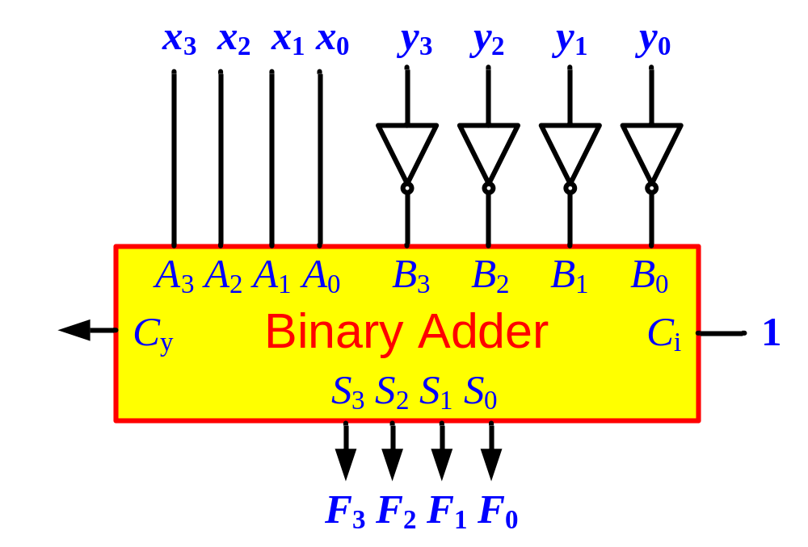
Binary Subtractor
Use 2’s complement with binary adder
  x – y = x + (-y) = x + y’ + 1
Eastern Mediterranean University
<number> / 65
Notes:
Princess Sumaya University
4241 - Digital Logic Design
Dr. Bassam Kahhaleh

Slide 24
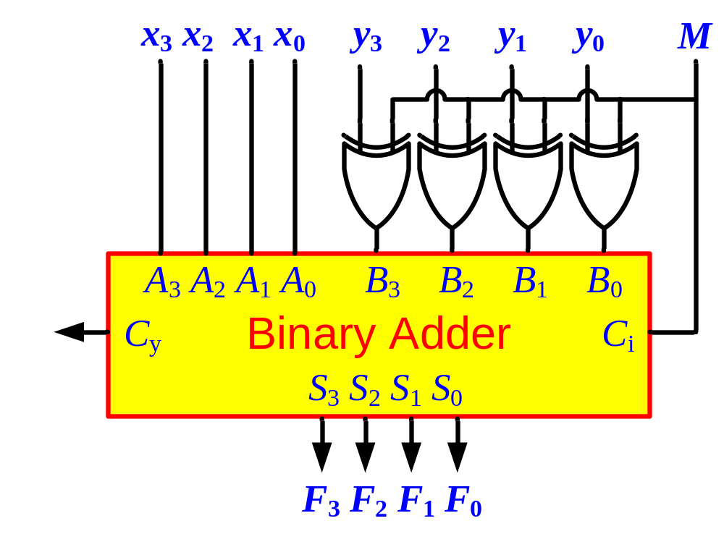
Binary Adder/Subtractor
M: Control Signal (Mode)
  M=0 ➔ F = x + y
  M=1 ➔ F = x – y
Eastern Mediterranean University
<number> / 65
Notes:
Princess Sumaya University
4241 - Digital Logic Design
Dr. Bassam Kahhaleh

Slide 25

Overflow
Unsigned Binary Numbers
2’s Complement Numbers
x₃ x₂ x₁ x₀
y₃ y₂ y₁ y₀
0
FA
FA
FA
FA
Carry
C₄ C₃ C₂ C₁
S₃ S₂ S₁ S₀
x₃ x₂ x₁ x₀
y₃ y₂ y₁ y₀
0
FA
FA
FA
FA
Overflow
C₄ C₃ C₂ C₁
S₃ S₂ S₁ S₀
Eastern Mediterranean University
<number> / 65
Notes:
Princess Sumaya University
4241 - Digital Logic Design
Dr. Bassam Kahhaleh

Slide 26
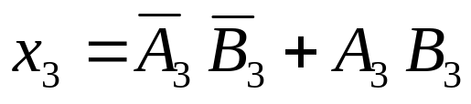
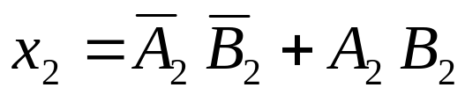
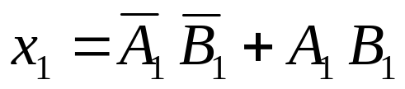
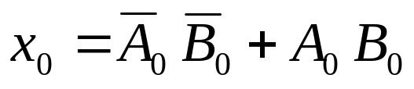
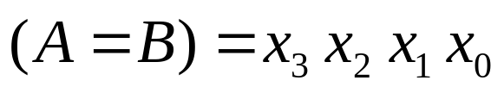
Magnitude Comparator
Compare 4-bit number to 4-bit number
  3 Outputs: < , = , >
  Expandable to more number of bits
A₃A₂A₁A₀ B₃B₂B₁B₀
Magnitude Comparator
A<B A=B A>B
Eastern Mediterranean University
<number> / 65
Notes:
Princess Sumaya University
4241 - Digital Logic Design
Dr. Bassam Kahhaleh

Slide 27
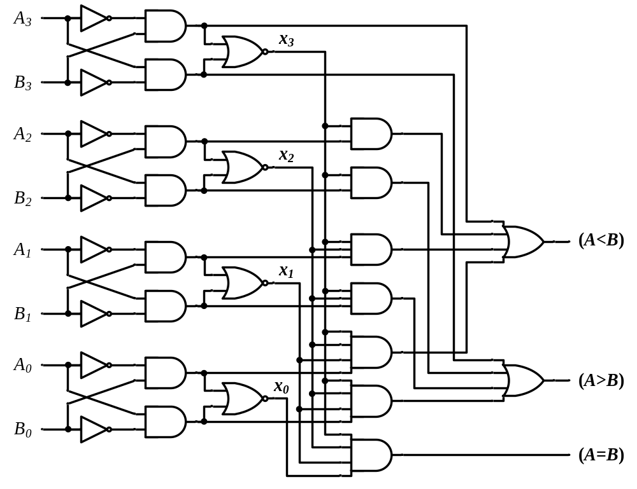
Magnitude Comparator
Eastern Mediterranean University
<number> / 65
Notes:
Princess Sumaya University
4241 - Digital Logic Design
Dr. Bassam Kahhaleh

